Slide 1

"LOAN APPROVAL ELIGIBILITY PREDICTION USING MACHINE LEARNING ALGORITHMS"
BATCH MEMBERS
1. M.CH V S MANIKANTA (20FE1A1236)
2. CH.MADHU ( 20FE1A1213)
(DEPARTMENT OF INFORMATION TECHNOLOGY)
Minor Project​
In​
COMMUNICATION​
DOMAIN​
​

Slide 2

ABSTRACT
Loan approval is a very important process for banking organizations. The system approved or reject the loan applications. Recovery of loans is a major contributing parameter in the financial statements of a bank.
It is very difficult to predict the possibility of payment of loan by the customer. In recent years many researchers worked on loan approval prediction systems.
Machine Learning(ML) techniques are very useful in predicting outcomes for large amount of data. In this paper three machine learning algorithms , Logistic Regression(LR) , Decision Tree(DT), Random Forest(RF) are applied to predict the loan approval of customers.

Slide 3

OBJECTIVE
Our aim from the project is to make use of pandas, matplotlib, & seaborn libraries from python to extract insights from the data , & scikit-learn libraries for machine learning.
Secondly, to learn how to hypertune the parameters using grid search cross validation for the machine learning model.
And in the end, to predict whether the loan applicant can repay the loan or not using voting ensembling techniques of combining the predictions from multiple machine learning algorithms.

Slide 4
INTRODUCTION
Distribution of the loans is the core business part of almost every banks. The main portion the bank’s assets is directly came from the profit earned from the loans distributed by the banks
Today many banks/financial companies approves loan after a regress process of verification and validation but still there is no surety whether the chosen applicant is the deserving right applicant out of all applicants.
Through this system we can predict whether that particular applicant is safe or not and the whole process of validation of features is automated by machine learning technique.
The disadvantage of this model is that it emphasize different weights to each factor but in real life sometime loan can be approved on the basis of single strong factor only, which is not possible through this system.
The Loan Prediction System can can automatically calculate the weight of each features taking part in loan processing and on new test data same features are processed with respect to their associated weight .

Slide 5
BASIC MACHINE LEARNING MODEL
TRAINING DATA
MODEL
PREDICTION

Slide 6
LITERATURE SURVEY
TITLE OF THE PAPER | AUTHOR NAME | INFERENCE | YEAR OF PULISHED | PUBLISHER
Loan prediction model using several Machine Learning (ML) algorithms | Goyal and Kaur | In this paper, an attempt is made to condense the risk involved in selecting the suitable person who could repay the loan on time thereby keeping the bank’s non-performing assets (NPA) on the hold. | 2018 | Machine Learning Springer
Implementation of Anomaly Detection Technique Using Machine Learning Algorithms | K. Hanumantha Rao, G. Srinivas, A. Damodhar, M. Vikas Krishna | In this paper, we present “machine learning” a method to cascade K-means clustering and the Id3 decision tree learning methods to classifying anomalous and normal activities in a computer network | 2019 | International Journal of Computer Science and Telecommunications

Slide 7
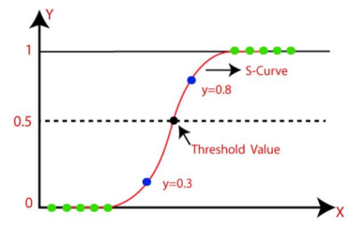
METHODOLOGY
The machine learning techniques used in this loan prediction code is
1. Logistic Regression
Logistic regression is a popular Machine Learning algorithm that falls under the Supervised Learning technique.
It is used to predict the categorical dependent variable from a given set of independent variables.
We fit an "S" shaped logistic function that predicts two maximum values instead of a regression line (0 or 1).
The output of a categorical dependent variable is predicted using logistic regression.
It can be Yes or No, 0 or 1, true or false, and so on, but instead of giving the exact values as 0 and 1, it gives the probabilistic values that fall between 0 and 1.
Fig. Logistic Regression

Slide 8
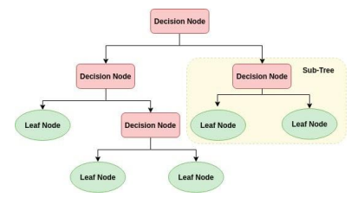
2. Decision Tree
The Decision Tree algorithm is a member of the family of supervised learning algorithms.
The goal of using a Decision Tree is to generate a training model that can be used to predict the class or value of the target variable (training data) by following the rules in the training data set.
When using Decision Trees to predict a class label for a record, we begin at the root of the tree. The values of the root attribute are compared to the values of the record's attribute.
We proceed to the next node by following the branch corresponding to that value based on the comparison. The accuracy achieved using Decision Tree by previous authors was varied around 0.82 .

Slide 9
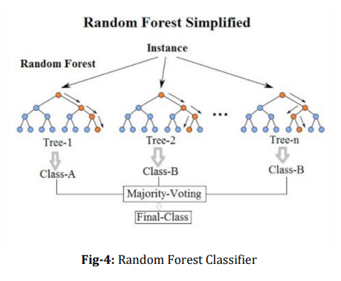
3. Random Forest Classifier
Random Forest is a supervised learning algorithm.
It creates a forest out of a collection of decision trees that are typically trained using the bagging method.
The bagging method's basic premise is that combining different learning models improves the overall result.
The random forest takes the predictions from each tree and predicts the final model based on the majority votes of predictions.
The greater the proportion of trees in the forest, the higher the precision and the less chance of overfitting.

Slide 10
A Company wants to automate the loan eligibility process (real time) based on customer detail provided while filling online application form.
These details are Gender, Marital Status, Education, Number of Dependents, Income, Loan Amount, Credit History and others.
To automate this process, they have given a problem to identify the customers segments, those are eligible for loan amount so that they can specifically target these customers. Here they have provided a data set.

Slide 11
DATA
Variable Descriptions:
Variable | Description
Loan_ID | Unique Loan ID
Gender | Male/ Female
Married | Applicant married (Y/N)
Dependents | Number of dependents
Education | Applicant Education (Graduate/ Under Graduate)
Self_Employed | Self employed (Y/N)
ApplicantIncome | Applicant income
CoapplicantIncome | Coapplicant income
LoanAmount | Loan amount in thousands
Loan_Amount_Term | Term of loan in months
Credit_History | credit history meets guidelines
Property_Area | Urban/ Semi Urban/ Rural
Loan_Status | Loan approved (Y/N)

Slide 12
MODEL BUILDING
Let us make our first model predict the target variable. We will start with Logistic Regression which is used for predicting binary outcome.
Logistic Regression is a classification algorithm. It is used to predict a binary outcome (1 / 0, Yes / No, True / False) given a set of independent variables
Logistic regression is an estimation of Logit function. The logit function is simply a log of odds in favor of the event.
This function creates an S-shaped curve with the probability estimate, which is very similar to the required stepwise function
After creating new features, we can continue the model building process. So we will start with the logistic regression model and then move over to more complex models like RandomForest and XGBoost

Slide 13
BLOCK DIAGRAM
Collection of Data set
Feature selection using info gain of features
Train model on training data set
Test the model on testing data set
Result analysis

Slide 14

SOFTWARE USED
GOOGLE COLABORATORY

Slide 15
RESULTS & DISCUSSION
Three machine learning approaches are applied on the test data to predict the loan approvals of loan requests. Python programming language is used to implement machine learning algorithms.
For training 70 percent data is used and 30 percent data is used for testing. The prediction accuracy of the different ML approaches is calculated and compared.
Comparison of prediction accuracy of machine learning algorithms
S.NO | MACHINE LEARNING ALGORITHMS | PREDICTION ACCURACY PERCENTAGE
1 | Logistic Regression | 86.17
2 | Decision Tree | 84.36
3 | Random Forest | 85.36

Slide 16
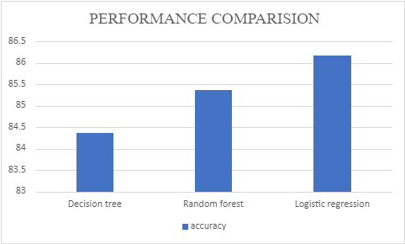

Slide 17
CONCLUSION
This paper applied machine learning in prediction of loan approval. Three ML algorithms are used to predict the loan approval status of customers for bank loans.
The results shown that the prediction accuracy is 84.36%, 85.36% and 86.17% for DT, RF algorithm LR algorithms respectively. Among three the accuracy of LR algorithm is best for prediction of loans.
In future the Decision Tree algorithm can be applied on other data sets available for loan approvals to further investigate its accuracy.
A rigorous analysis of other machine learning algorithms other than these three can also be done in future to investigate the power of machine learning algorithms for loan approval prediction.

Slide 18
REFERENCES
Vaidya, "Predictive and probabilistic approach using logistic regression: Application to prediction of loan approval," 2017 8th International Conference on Computing, Communication and Networking Technologies (ICCCNT), Delhi, 2017.
A.Li and Q. Sun, "The Risk of Loan Consuming by SMEs Based on the Supply Chain," 2012 International Conference on Management of eCommerce and e-Government, Beijing, 2012, pp. 356-359.doi: 10.1109/ICMeCG.2016.24
J. Lohokare, R. Dani and S. Sontakke, "Automated data collection for credit score calculation based on financial transactions and social media," 2017 International Conference on Emerging Trends & Innovation in ICT (ICEI), Pune, 2017.
Anchal Goyal , Ranpreet Kaur-“Loan Prediction Using Ensemble Technique”, International Journal of Advanced Research in Computer and Communication Engineering Vol. 5, Issue 3, March 2018 .
V. C. T. Chan et al., "Designing a Credit Approval System Using Web Services, BPEL, and AJAX," 2009 IEEE International Conference on eBusiness Engineering, Macau, 2019.

Slide 19
THANK YOU

